Slide 1

Histology
جامعة ساوة
كلية الصيدلـــــــــــــــــــــــــــــــة
المرحلة الأولى
Ali.H.Al Basheer
MSc histology
1

Slide 2
Histology is a term derived from histo : tissue , and logy , study .It's the study of the tissues of the body & of how these tissues are arranged to constitute organ .
The human body is composed of only four basic types of tissues: epithelial , connective ,muscular & nervous
Epithelial tissues: are composed of closely aggregated polyhedral cells with very little extracellular substance .
The principal functions of epithelial tissue :
1.The covering , lining of the surface & protection ( e.g. Skin , intestine )
2- Absorption ( e.g. Intestines )
3.Secretion ( e.g. epithelial cells of glands )
4.Sensation ( e.g. Gustative & olfactory neuroepithelial cells line all external & internal surfaces of the body , everything that enters or leaves the body must cross an epithelial sheet .
5.Transport as in transport of materials or cells along the surface of an epithelium.
6.Contractility (e.g. myoepithelial cells ) .
Almost all epithelial cells , whether lining a surface or forming gland units , rest on a connective tissue .

Slide 3
Basal Lamina & Basement membrane
Epithelium is made almost entirely of contiguous & adhesive cells bound together by intercellular junctions & a small amount of extracellular matrix .
All epithelial cells in contact with subjacent connective tissue have at their surfaces a felt – like sheet of extracellular material called basal lamina , which appear as a dense layer or lamina densa , consisting of a delicate network of very fine fibrils . Also the basal laminae may have an electron – lucent layer called lamina Lucida or clear layer on one or both sides of the dense layer .
The macromolecular components of basal laminae include:
laminin
Type IV collagen
Entactin (nidogen)
The basal lamina have many function :-
  Supporting the cells .
  Provide a barriers that limits or regulates the exchange of macromolecules between connective tissue & cells of other tissues .
  Able to influence cell polarity .
  Regulate cell proliferation & differentiation by binding with growth factor . 5- Influence cell metabolism .
The epithelium lack a direct blood supply & are fed via diffusion from underlying tissues during basement membrane and receive a rich supply of nerve endings from nerve plexuses in the lamina propria

Slide 4
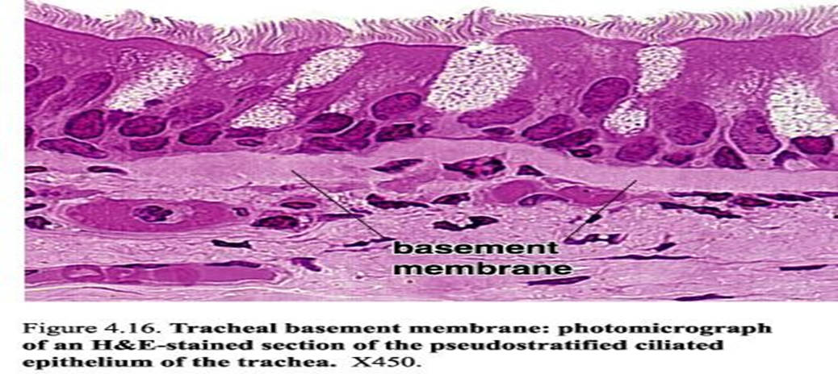

Slide 5
Types of Epithelium
Epithelia are divided into groups according to their structure & function :-
1- Covering or lining epithelia . 2- Glandular epithelia
The covering epithelia are tissues in which the cells are organized in layers that cover the external surface or line the cavities of the body .
They are classified according to the number of cell layers & the morphologic features of the cells in the surface layer :
A- Simple epithelia contain only one layer of cells .
B- Stratified epithelia contain more than one layer .
The simple epithelia are classified according to cell shape :
1) Simple Squamous 2) Simple Cuboidal 3) Simple Columnar 4)Pseudostratified Columnar Epithelium

Slide 6
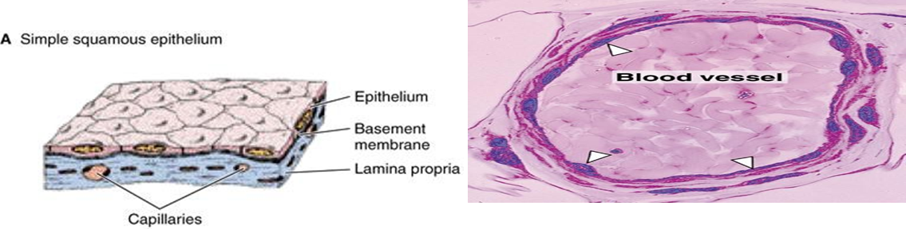
1. Simple squamous epithelial tissue: this type of tissue is formed from one layer of squamous cells that line surfaces. They are large, thin, and flat and contain a rounded nucleus which is found lining areas where passive diffusion of gases occurs.
Location: skin, walls of capillaries, linings of the pericardial, pleural, and peritoneal cavities, as well as the linings of the alveoli of the lungs.

Slide 7
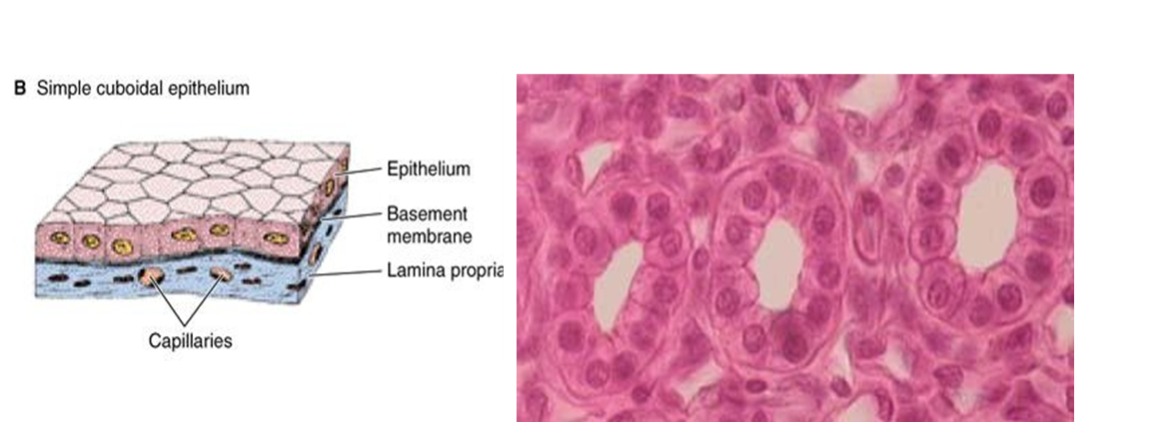
2. Simple cuboidal epithelial tissue: Cells that have a basic cube shape. Typically, the cell's height and width are about equal.
Function: have role in secretory, absorptive, or excretory functions.
Location: in small collecting ducts of kidney, pancreas, and salivary glands .

Slide 8
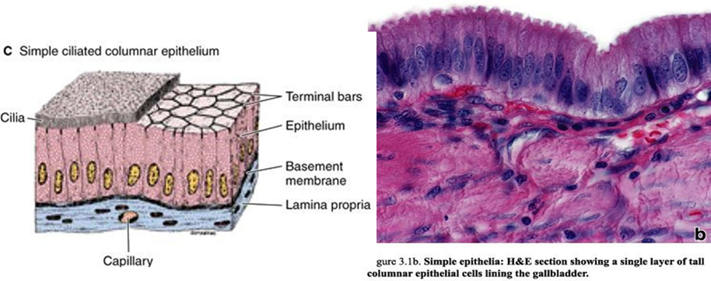
3. Simple columnar epithelial tissue: tall, rectangular, or column-shaped cells. Typically, taller than they are wide.
Function: Absorption; secretion of mucus, enzymes, and other substances.
Location: non-ciliated type lines most of the digestive tract (stomach to anal canal), gallbladder and excretory ducts of some glands; ciliated variety lines small bronchi, uterine tubes, and some regions of the uterus.

Slide 9
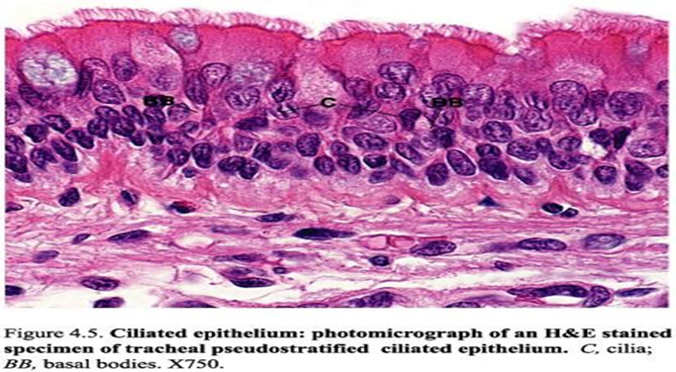
4. pseudostratified columnar epithelium
A single layer of cells that appears to be multiple layers due to variance in height and location of the nuclei in the cells. they can be confused with stratified epithelia.
Function: absorption, transportation, Secretion
Location: Non-ciliated type in male's sperm-carrying ducts and ducts of large glands. lines the trachea, most of the upper respiratory tract.

Slide 10
B- Stratified epithelium are classified according to the cell shape of the superficial layer:
Stratified squamous epithelium :-
It is a multilayered epithelium & the name derives from the shape surface layers have flattened cells & deepest layer is in contact with basal lamina are cuboidal or columnar in shape & the intermediate layers above the basal layer have irregular polyhydral cells .
This epithelium mainly protects against abrasion & dehydration .
This epithelium can be:
stratified squamous keratinized epithelium is found in the epidermis of skin . The surface layer consists of dead cells lacking nuclei & containing plates of the protein keratin & helps protect against water loss & protection .
The stratified squamous non – keratinized epithelium It is lines wet cavities as mouth , esophagus & vagina . In such areas where water loss is not a problem, the flattened cells of the epithelial surface layer containing much less keratin and retaining their nuclei. The main function of this epithelium , protection , secretion , prevents water loss

Slide 11
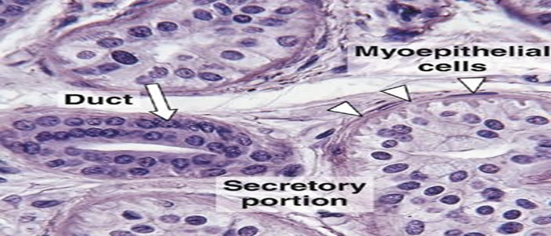
2-Stratified Cuboidal Epithelium
It is consist of usually two layers of cuboidal cells & are rare & lines the large excretory ducts of sweat gland , salivary glands & developing ovarin follicles . The main function , protection & secretion .

Slide 12
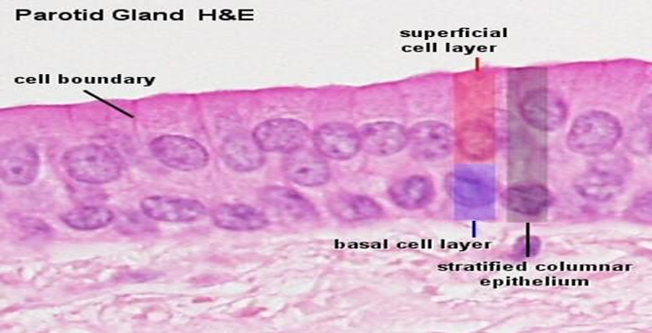
3.Stratified Columnar Epithelium
It is usually consists of two to five layers of cells , the basal cells (cuboidal) , intermediate cells (more polyhedral) & superficial cells (Columnar) & also distribution of this epithelium is limited & lines the parts from urethra , conjunction lining the eyelid . The function of this epithelium are protection & secretion .

Slide 13
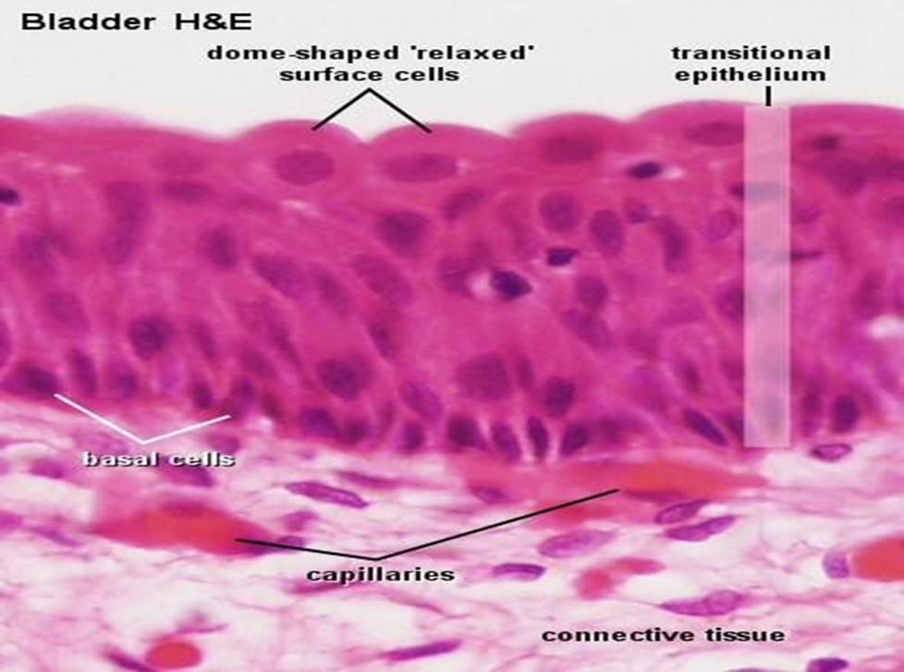
4.Transitional Epithelium
it’s found in tissues that stretch, and it can appear to be stratified cuboidal when the tissue is not stretched or stratified squamous when the organ is expanded, and the tissue stretches. It found in the bladder, ureters and urethra.

Slide 14
Glandular epithelia
Glandular epithelia are formed by cells specialized to produce secretion . The molecules to be secreted are generally stored in the cells in small membrane – bound vesicles called secretory granules .
The glandular epithelia may synthesize , store & secrete protein (e.g. in the pancreas ) , lipids (e.g. adrenal , sebaceous glands ) or complexes of carbohydrates & proteins (e.g. Salivary glands ) . The mammary glands secrete all three substances .
Types of Glands
All glands classified into major groups on the basis of method of distribution of the secretory products .
Exocrine glands have a secretory portion , contain the cells specialized for secretion & these glands are retain their connection with the surface epithelium , the connection taking the form of tubular ducts lined with epithelial cells through which the secretions pass to the surface .
Endocrine glands are ductless & release products , called hormones directly into the bloodstream .

Slide 15
Connective Tissue
Connective tissue consists of three main components: cells, protein fibers, and a ground substance. Together the fibers and ground substance make up the extracellular matrix. Whereas the other tissue types (epithelium, muscle, and nervous tissue) are largely made up of cells, the extracellular matrix is the major component of most connective tissue. Three types of fibers are found in connective tissue:
1- Collagen Fibers. 2- Elastic fibers. 3- Reticular fibers.
Classification of Connective Tissues
Categories of connective tissue include the following:
  Loose Connective Tissue – large amounts of ground substance and fewer fibers
  Dense Connective Tissue – large amounts of fibers and less ground substance
  Cartilage – specialized cells called chondrocytes are within the matrix (cartilage cells)
  Bone – strongest connective tissue with little ground substance, hard matrix of calcium and phosphorous and specialized bone cells called osteocytes.
  Blood – fluid connective tissue, no fibers – only ground substance (plasma) and cells (red, white, and platelets).

Slide 16
Muscular Tissue
Muscle tissue is one of the basic tissue types. Histologically, the muscles of the body can be classified into 3 types: skeletal, smooth, and cardiac. The 3 types of muscle tissue are based on the morphologic and functional properties of the cells.
There are 3 types of muscle tissue based on morphologic and functional differences:
Skeletal muscles:
  Movement of skeleton and other structures (e.g., the eyes)
  Long, multinucleated cells with striations
  Primarily under voluntary control (though some actions are automatic)
Smooth muscles:
  Walls of vessels/hollow organs (e.g., intestines, blood vessels)
  Fusiform cells without striations (lack banding pattern)
  Slower, involuntary contractions
Cardiac muscle/ myocardium :
  Form most of the walls of the heart
  Striated, elongated, branched cells
  Under involuntary control

