Slide 1

الوراثة الطبية 1 / الكورس الاول
The chromosomal abnormalities
Sawa University
College of health and medical techniques
Department of Medical Laboratories
Third Stage
جامعــــــــــة ســــــــــــاوة الاهلية
كليـــــــة التقنيــــات الصحيـة والطبيـة
قسم تقنيات المختبرات الطبية
المرحلــــــــــــــــــــــة الثالثة
محاضرة رقم 6
الجانب النظري : الوراثة الطبية
Lecture No. 6
Theoretical : Medical Genetics
تدريسي المادة : م. د عباس علي

Slide 2
Learning Objectives
By the end of this lecture, you will be able to:
Define chromosomal disorders as changes in number or structure.
Distinguish numerical from structural aberrations.
List key structural types: deletion, duplication, translocation, inversion.
Explain non-disjunction mechanisms causing aneuploidy.
Identify clinical features of Turner, Klinefelter, and Down syndromes.

Slide 3
Chromosomal Abnormalities
What Are Chromosomal Disorders?
A chromosomal disorder occurs when there is a change in the number or structure of the chromosomes.
This change in the amount, or arrangement of, the genetic information in the cells may result in problems in growth, development, and/or functioning of the body systems.
Types of Chromosomal Abnormalities
There are two main types of chromosomal abnormalities :
Numerical Aberrations – changes in chromosome number
Structural Aberrations – changes in chromosome structure

Slide 4
Structural Aberrations
Structural chromosome rearrangements are changes in the physical structure of chromosomes that may result in:
birth defects
mental retardation
increased risk for infertility
pregnancy loss
Due to:
chromosomal breakage or unequal crossing over which result in:
  Deletions
  ring chromosomes
  Duplications
  Translocations
  insertions
  inversions

Slide 5
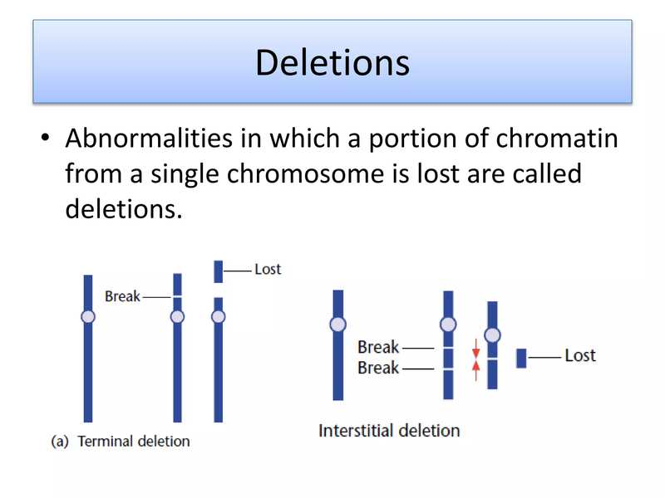
Deletions
Deletions result in loss of a chromosome segment
Terminal deletions are caused by a single break with loss of the segment distal to the break.
Interstitial deletions result from two breaks in a chromosome, loss of the intervening segment, and reunion of the breakpoints.

Slide 6
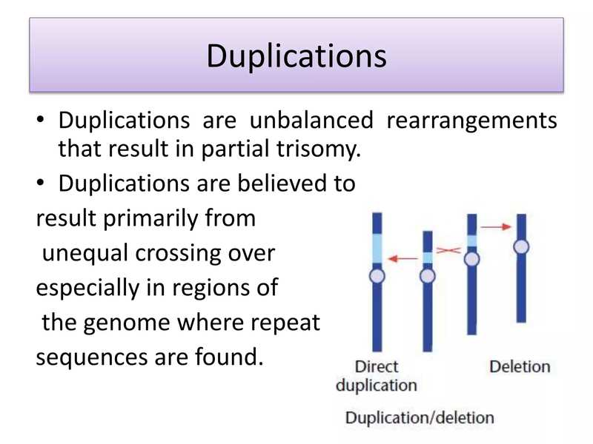
Duplications
Duplications are unbalanced rearrangements that result in partial trisomy.
Believed to result from unequal crossing over,
especially in regions of the genome where repeat sequences are found.
Types:
Direct duplication
Deletion/duplication

Slide 7
Translocations
Translocations involve breaks in two different chromosomes with an exchange of segments.
In humans, there are two major types of translocation:
Reciprocal translocations – in which there is no visual loss of chromatin
Robertsonian translocations – in which the long arms of two acrocentric chromosomes are joined, with loss of the two short arms

Slide 8
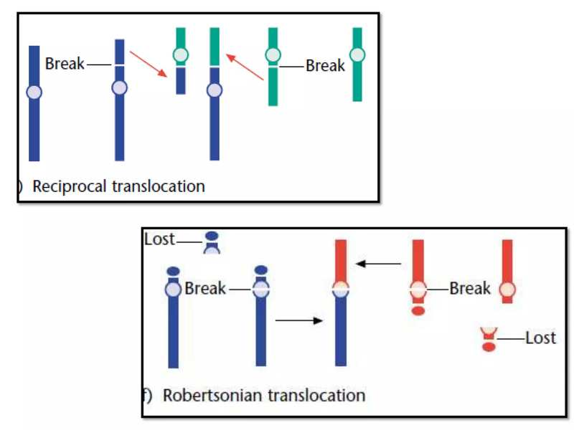

Slide 9
Inversions
Inversions occur when two breaks happen within the same chromosome, and the intervening segment rotates 180° before reinserting itself into the chromosome. This rearrangement alters the gene sequence but usually does not result in a loss of genetic material.
There are two main types of inversions:
Pericentric inversion: breaks occurring in both arms of the chromosome and involves the centromere.
Paracentric inversion: occurs within a single arm of the chromosome and does not involve the centromere.
Before the inversion: A – B – C – centromere – D – E
After the inversion: A – B – D – centromere – C – E
Before the inversion: A – B – C – D – E
After the inversion: A – B – D – C – E

Slide 10
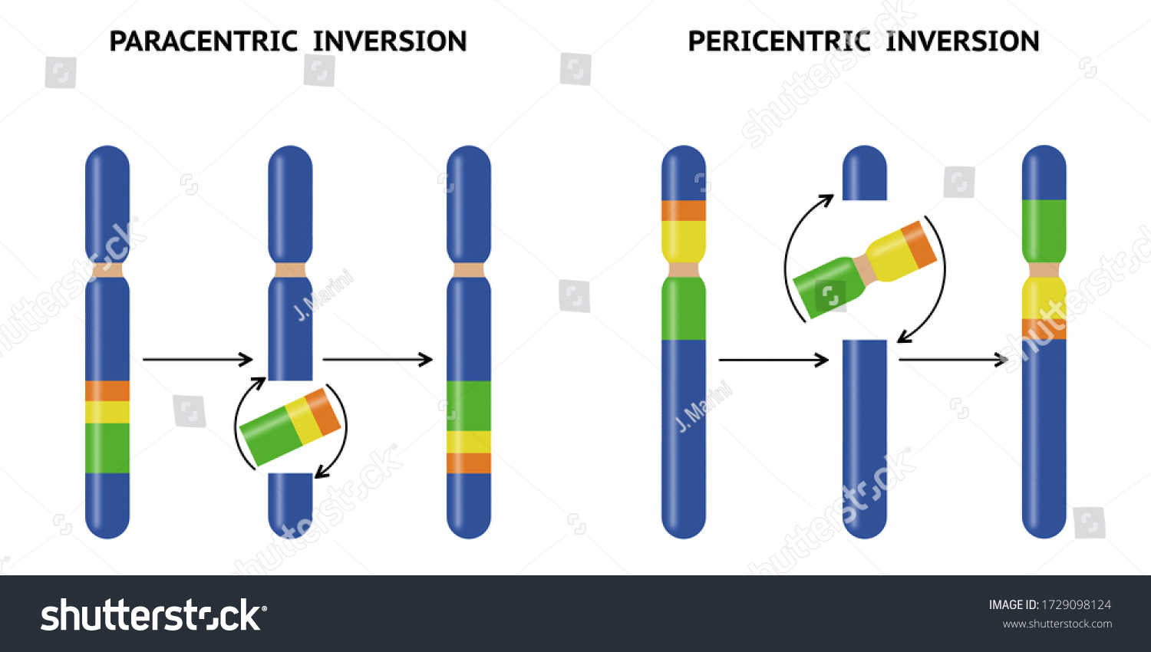

Slide 11
Numerical Aberrations
Numerical aberrations represent a significant proportion of chromosomal changes found in humans.
Constitutive numerical aberrations (present in all cells) – due to meiosis
Mosaic numerical aberrations (present in some cells) – due to mitosis
They are a major cause of:
Pregnancy loss
Abnormalities in live births
Trisomy 21 → Down syndrome
Trisomy 18 → Edward syndrome
Trisomy 13 → Patau syndrome

Slide 12
Meiotic Non-disjunction
Chromosome non-disjunction is defined as the unbalanced segregation of chromosomes, leading to aneuploidy.
It may occur at:
Meiosis I – when homologous chromosomes fail to segregate to opposite poles
Meiosis II – when sister chromatids fail to separate at the centromere and segregate to opposite poles

Slide 13
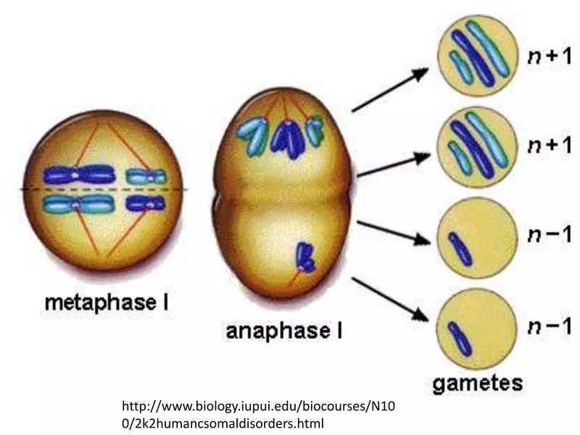

Slide 14
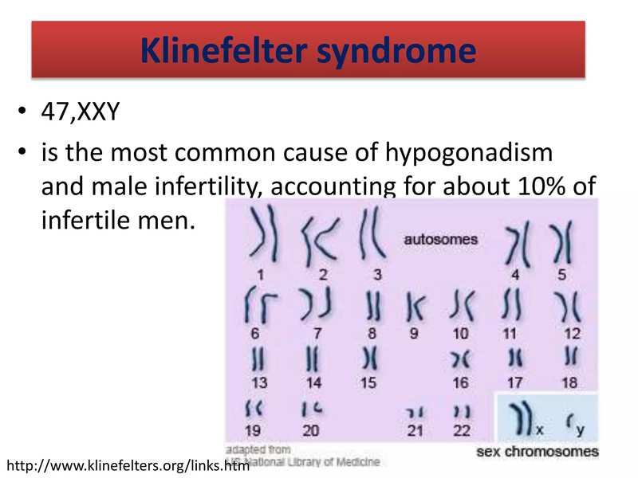
Klinefelter Syndrome
47,XXY
Most common cause of hypogonadism and male infertility
Accounts for ~10% of infertile men

Slide 15
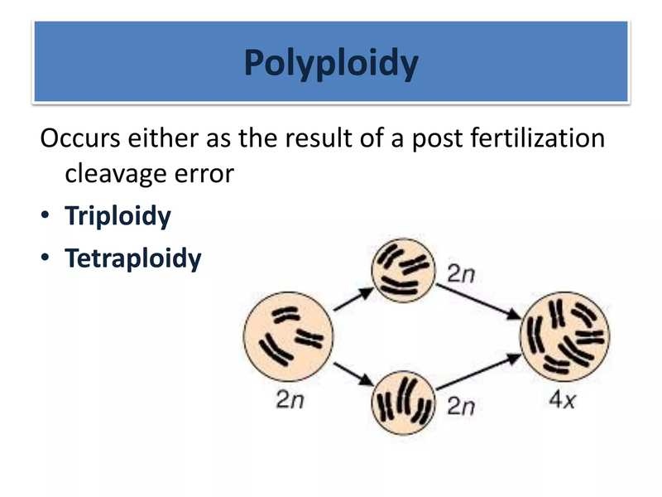
Polyploidy
Polyploidy can occur before fertilization (due to errors in meiosis producing diploid gametes) or after fertilization (due to errors in early mitotic divisions). It results in extra complete sets of chromosomes (e.g., triploidy 3n or tetraploidy 4n)
Type | Number of groups | Number of chromosomes
(diploid) normal | 2n | 46
Triploidy | 3n | 69
Tetraploidy | 4n | 92

Slide 16

Any questions?

